Slide 1
Database Applications with JDBC in Java SE applications
COURSE OVERVIEW

Slide 2
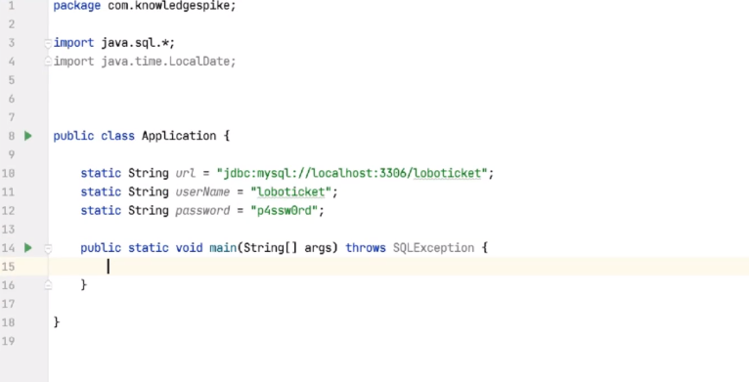

Slide 3
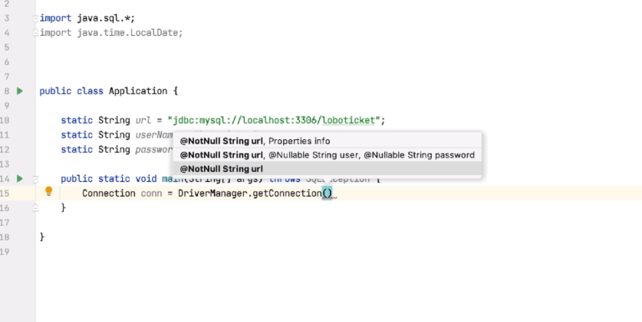

Slide 4
